Slide 1

Data Base Management System
PROJECT PRESENTATION
TOPIC :
ICTS PRINTING SERVICE
Group Members: -
P. CHETHAN SAI KUMAR REDDY (AM.EN. U4CSE19243)
M.GOWTHAM (AM.EN. U4CSE19234)
D B R S PRANEETH VARMA (AM.EN. U4CSE19265)
Y. PHANI VARDHAN (AM.EN. U4CSE19241)
Group : 7

Slide 2
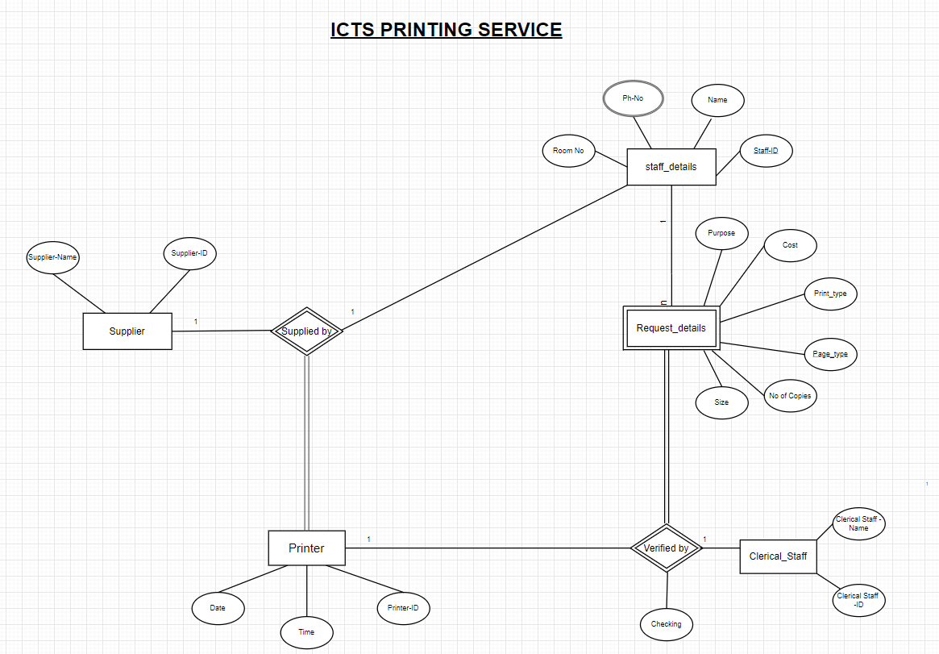
D
ER DIAGRAM
ICTS PRINTING SERVICE

Slide 3
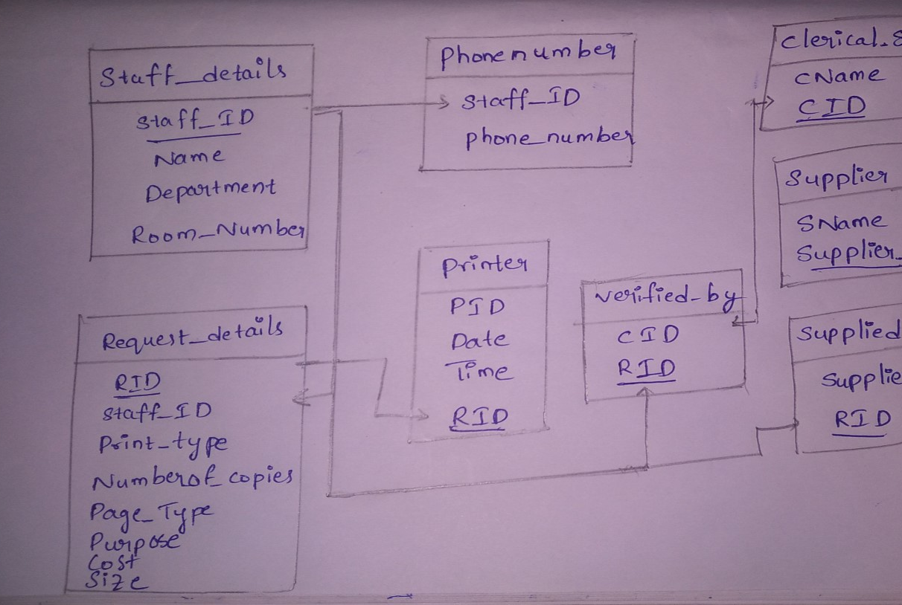
Relational schema

Slide 4
D
RELATIONAL SCHEMA
Table Name: - Request_details
Column Name | Data Type | size | Constraints
RID | varchar | 50 | primary key
Staff_ID | varchar | 50 | references to Staff_details(Staff_id)
Print_Type | varchar | 50 | not null
Number_of_Copies | integer | ____ | not null
Page_Type | varchar | 50 | not null
Purpose | varchar | 100 | not null
Cost | integer | ____ | not null
Sizes | varchar | 50 | not null
Table Name: - Staff_details
Column Name | Data Type | size | Constraints
Name | varchar | 50 | not null
Staff_ID | varchar | 50 | primary key
Department | varchar | 50 | not null
Room_Number | integer | 4 | not null
ICTS PRINTING SERVICE

Slide 5
Table Name: - Clerical_Staff
D
RELATIONAL SCHEMA
Column Name | Data Type | size | Constraints
Name | varchar | 50 | not null
CID | varchar | 20 | Primary key
Table Name: - Printer
Column Name | Data Type | Size | Constraints
PID | integer | ____ | Not null
RID | varchar | 50 | references to Request_ details(RID)
Date | date | ____ | not null
Time | time | ____ | not null
Table Name: - phonenumber
Column Name | Data Type | size | Constraints
Staff_ID | varchar | 50 | references to Staff_details(staff_ID)
Phone_Number | numeric | 20 | not null
ICTS PRINTING SERVICE

Slide 6
D
RELATIONAL SCHEMA
Table Name: - Supplier
Column Name | Data Type | Size | Constraints
SName | varchar | 50 | not null
Supplier_ID | varchar | 10 | Primary key
Table Name: - Supplied_by
Column Name | Data Type | Size | Constraints
Supplier_ID | varchar | 10 | references to Supplier(Supplier_ID)
RID | varchar | 50 | References to Request_details(RID)
ICTS PRINTING SERVICE

Slide 7
INSERTING into TUPLES:
insert into Staff_details values
('chethan','S1','CSE',250),
('gowtham','S2','ECE',253),
('praneeth','S3','EEE',242),
('phani','S4','CSE',134),
('mahesh','S5','ME',257),
('kalyan','S6','ECE',150);
insert into Request_details values
('R1','S2','Black_n_White',4,'single','A3','personal',40),
('R2','S3','Black_n_White',2,'double','A4','examination',30),
('R3','S4','Colour',5,'double','A4','official',60),
('R7','S5','Colour',6,'single','A3','personal',50),
('R4','S1','Black_n_White',4,'double','A4','examination',35),
('R5','S6','Colour',5,'single','A3','personal',45),
('R6','S3','Colour',3,'double','A4','official',55),
('R8','S1','Colour',3,'double','A4','official',55);
D
QUERIES
CREATING TABLES:
CREATE TABLE Staff_details(Name varchar(50) not null,staff_ID varchar(50) primary key,Department varchar(50) not null,
Room_Number int);
CREATE TABLE phonenumber(Staff_ID varchar(50),Phone_Number numeric(50),
foreign key(Staff_ID)references Staff_details(staff_ID))
CREATE TABLE Request_details(RID varchar(50) primary key,Staff_ID varchar(50),print_Type varchar(50),Number_of_copies int,Page_Type varchar(50),Sizes varchar(50),
foreign key(Staff_ID)references Staff_details(staff_ID),Purpose varchar(100),cost int);
CREATE TABLE Clerical_Staff(CName varchar(50),CID varchar(20) primary key)
create table verified_by(CID varchar(20),RID varchar(50),Checking varchar(50) CHECK(checking in('valid','invalid')),foreign key(CID) references Clerical_Staff(CID),
foreign key(RID) references Request_details(RID))
CREATE TABLE Printer(PID int ,RID varchar(50),Date date,Time time,foreign key(RID) references Request_details(RID));
CREATE TABLE Supplier(SName varchar(50),supplier_ID varchar(10) primary key)
CREATE TABLE Supplied_by(Supplier_ID varchar(10) ,RID varchar(50),foreign key(Supplier_ID) references supplier(Supplier_ID),
foreign key(RID) references Request_details(RID))
insert into verified_by values
('C1','R3','valid'),
('C2','R2','valid'),
('C3','R5','invalid'),
('C4','R7','invalid'),
('C1','R1','valid'),
('C3','R8','valid'),
('C2','R4','valid'),
('C4','R6','valid');
INSERT INTO Printer values
(1,'R3','2019-11-11','19:30:10'),
(2,'R6','2019-10-11','20:10:12'),
(3,'R1','2019-12-11','9:11:22'),
(4,'R4','2019-11-12','10:22:01'),
(5,'R2','2019-12-12','11:22:01'),
(2,'R8','2019-12-09','8:45:00');
insert into phonenumber values
('S1',9398993549),
('S1',9346707450),
('S2',9999999999),
('S3',9000000009),
('S4',7660914680),
('S4',7446383764),
('S5',8938849485),
('S6',9391621641);
insertinto Clerical_Staff values
('Pavan','C1'),
('sharukh','C2'),
('Ganesh','C3'),
('Hari','C4');
insert into supplier values
('sachin','SUP1'),
('virat','SUP2'),
('dhoni','SUP3'),
('karun','SUP4');
ICTS PRINTING SERVICE

Slide 8
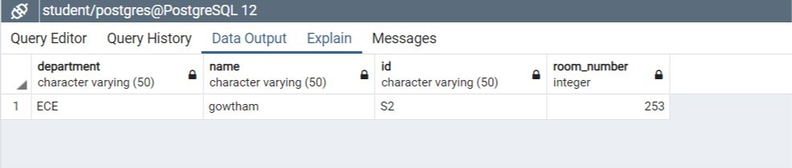
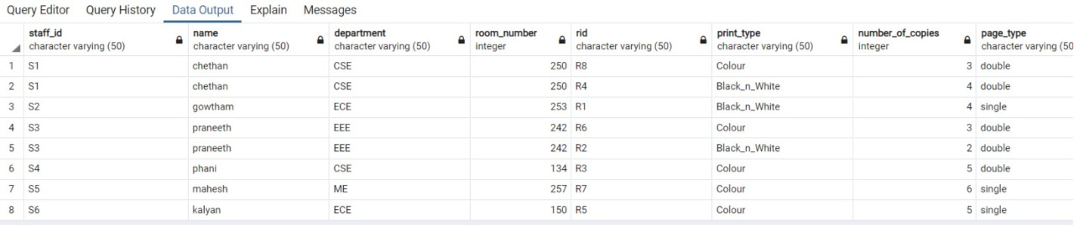
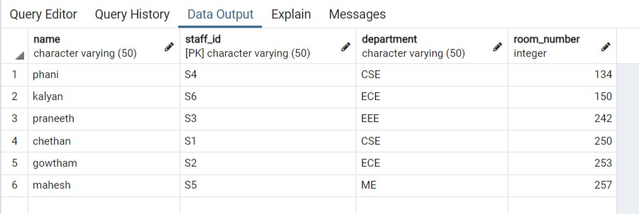
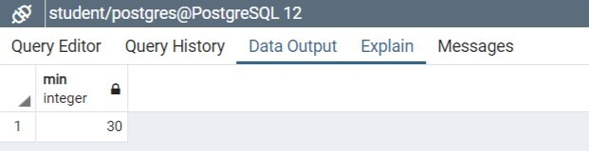
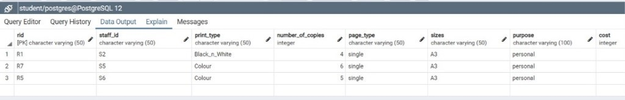
i) USECASE:
Displays Department,Name,ID,Room_Number of the requested staff whose room number is 253.
QUERY:
SELECT Department,Name,staff_ID AS ID,Room_Number from Staff_details where Room_Number=253 group by(staff_ID) HAVING Name is not null;
D
QUERIES
ii) USECASE: Displays all the details of the table Staff_details but in the order of their
Room Numbers (Ascending order).
QUERY: select * from Staff_details order by Room_Number;
iii) USECASE: Display all the details from Staff_details associated withRequest_details.
QUERY: select * from Staff_details natural join Request_details;
IV)
USECASE: Retrieve minimum cost;
QUERY:
select min(cost) from Request_details;
v)
USECASE: Displays all the values of Required_Conditions table where number of copies requested should >3 and size can be A3.
QUERY:
select * from Request_details where Number_of_copies>3 and (sizes='A3');
vi)
USECASE: increasing the cost of a Request for color prints by 20%
QUERY: update Request_details set cost=cost*1.2 where print_type='Colour';
ICTS PRINTING SERVICE

Slide 9
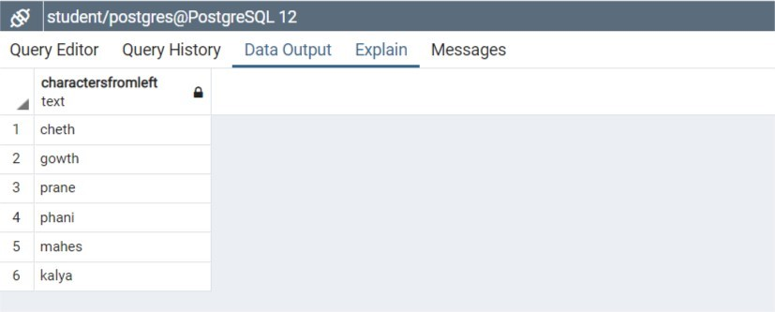
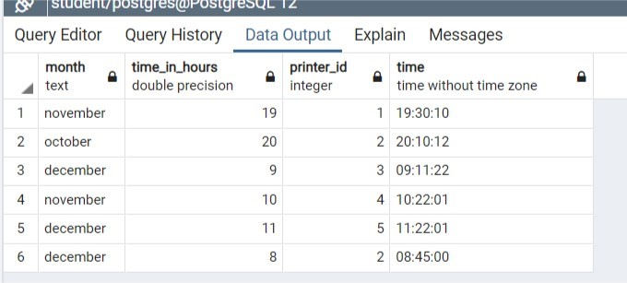
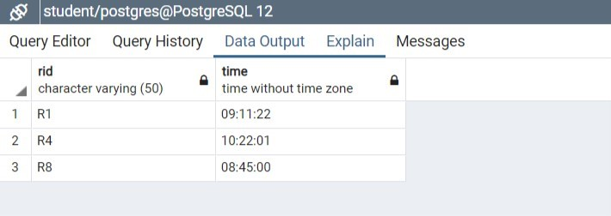
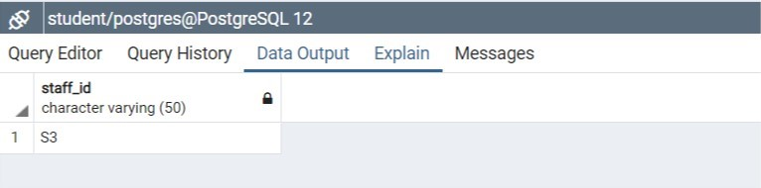
vii)
USECASE: Write a query which Extracts a number of characters from a string (starting from left) i.e., name of a staff;
QUERY: select LEFT(Name,5) as characters fromleft from Staff_details;
D
QUERIES
viii)
USECASE: Displays the month at which the printer is used ; time in hours ;exact time and its ID
QUERY:
SELECT TO_CHAR(Date,'month')as MONTH,extract(hour from Time) as time_in_hours, PID AS PRINTER_ID,TIME AS TIME FROM PRINTER;
ix)
USECASE: Retrive the Request_id,time which was printed between 8:00:00 and 11:00:00.
QUERY:
select RID,time from Printer where time between '8:00:00' and '11:00:00';
x)
USECASE: select the intersection of two conditions where name
name should start with p and purpose should be examination;
QUERY:
(select staff_ID from Staff_details where Name like 'p%')INTERSECT(select staff_ID fromRequest_details where purpose='examination');
ICTS PRINTING SERVICE

Slide 10
D
NORMALIZATION
PRINTINGSERVICE (Name,Staff_ID,Departmen,Room_number ,Phone_number,RID,Print_type,Number_of_copies,
Page_Type,Purpose,Cost,Cname,CID,Checking,PID,Date,Time,SName,Supplier_ID)
1NF
A)
:
Conditions for the relation to become in the First Normal Form are-
i) A Relation is in First Normal form if it does not contain any composite or Multi-valued attribute, or all attributes are single valued attributes.
Phone_Number is a Multivalued Attribute. So, separating it with Staff_ID gives the table in 1NF.
Phonenumbers(Staff_ID,Phone_Number)
FUNCTIONAL DEPENDIENCES:
Staff_ID →Name,Department,Room_Number,Phone_Number
RID →Print_type,Numbr_of_Copies,Page_Type,Purpose,Cost,Sizes
Clericalstaff_ID →CName
Supplier_ID →SName
Printer_ID ,RID→Date,Time
Here if we check the functional dependencies it’s clear that it is the only Candidate key for the relation.
Prime Attributes are: Staff_ID,ClD,Supplier_ID,RID.
ICTS PRINTING SERVICE

Slide 11
D
NORMALIZATION
2NF
B)
:
Conditions to be satisfied to be in Second Normal Form are -
i) Relation must be in first normal form and
ii) Relation must not contain any partial dependency
Here,
Staff_details(Name ,staff_ID ,Department ,Room_Number)
Phonenumbers(Staff_ID,Phone_Number)
Request_details(RID ,Staff_ID,print_Type,Number_of_copies,Page_Type ,Sizes,Purpose ,cost )
Clerical_Staff(CID,Name)
Verified_by(CID,RID)
Supplier(Supplier_ID,Name)
Supplied_by(Supplier_ID,RID)
Printer(PID,Date,Time,RID)
ICTS PRINTING SERVICE

Slide 12
D
NORMALIZATION
3NF
C)
:
Conditions to be satisfied to be in Third Normal Form are,
i) Relation is already in second normal form .
ii) Relation must not have any transitive functional dependency for non-prime attributes .
Here, all our tables in 2NF are already in 3NF also, as there is no transitive functional dependency in these relations.
BCNF: -
D)
All our tables are in BCNF.
Comparison of ER and Normalized tables:
So, on normalisation we got the same relations that we got when we converted ER diagram to Relational Schema.
ICTS PRINTING SERVICE

Slide 13


